Slide 1
Treasures and Mysteries
“To give glory to God the Creator”
By
The Knights of the Trinity

Slide 2
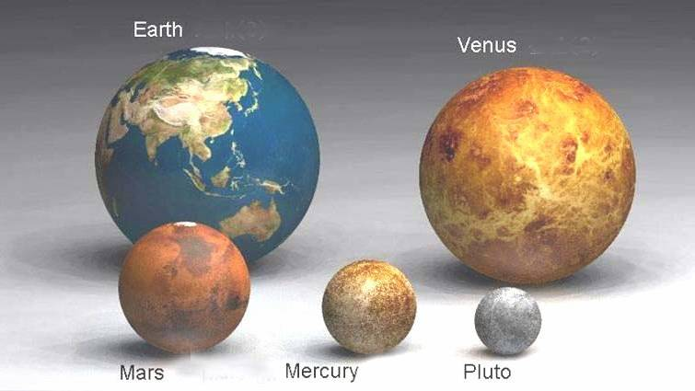
The Universe as we know it
(so far)

Slide 3
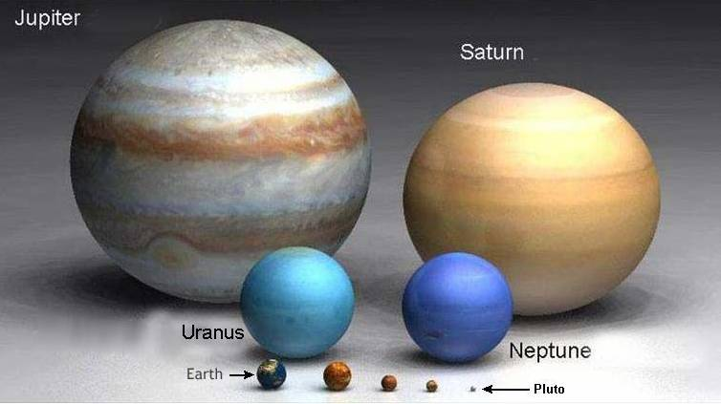
1st Law of Physics

Slide 4
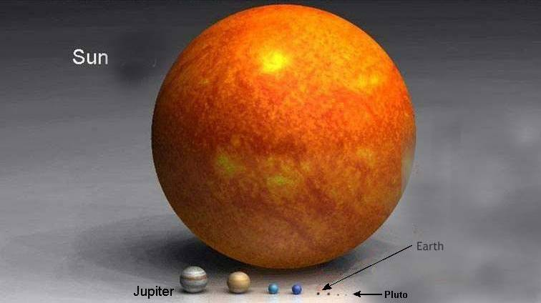
Matter cannot be created nor destroyed

Slide 5
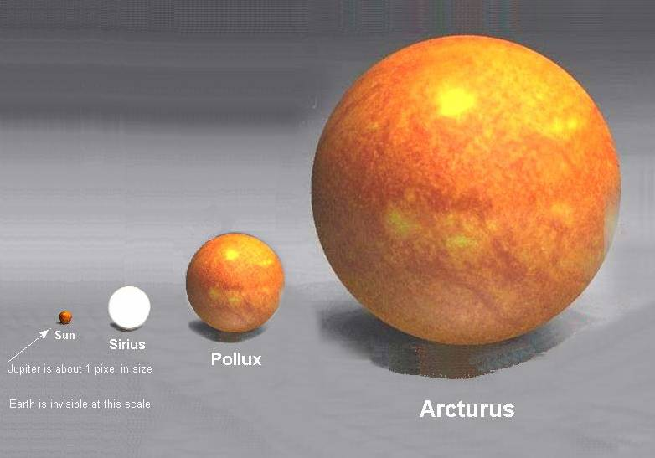
But can change its form

Slide 6
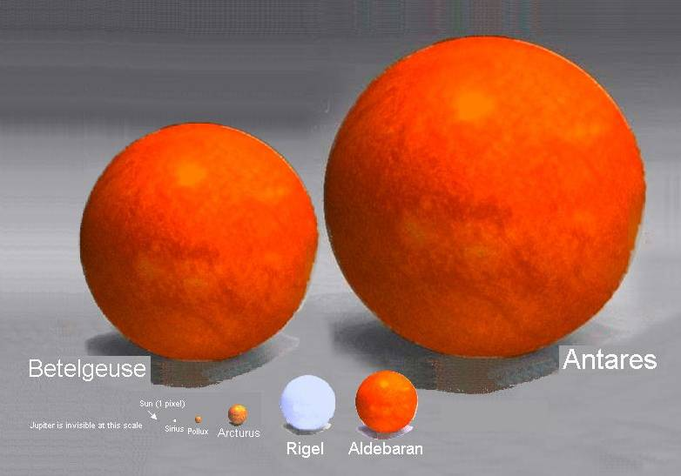
See “Pascal’s Wager”

Slide 7

Where did all this matter come from if not the creator - GOD

Slide 8
Origins
Evolution
  Big Bang
  Where did it all the material come from
  Where did plants come from
  Where did animals come from
  Where did humans come from
Creationism
  God created it all

Slide 9
Creation vs. Evolution
http://www.youtube.com/watch?v=Up-0E4Qetfg&feature=related

Slide 10
Pascal’s Wager
If you do not believe in God and there is a God where will you spend all Eternity?
If you do not believe in God and there is no God then you may win in this life
If you believe in God and there is a God you win if you do his will and you spend all Eternity with Him in Heaven

Slide 11
Catholics
Religion founded by Jesus who we believe to be the son of God the Creator
We believe He worked many miracles and fulfilled the prophets of the Old Testament
He died on the Cross for our sins against His Father
He has worked many miracles since His death and appeared to many

Slide 12
What we believe
Jesus is the Son and third person of the Blessed Trinity
Jesus left His Church in the leadership of Peter as the first Pope and said that His Church will last till the end of time
We must go to mass on Sundays and Holidays of Obligation and receive communion during the season of Lent and go to confession once a year

Slide 13
Our beliefs
That the mother of Jesus and Jesus being God the Son thus Mary has the title of Mother of God
God is a Trinity of the Father, Son and Holy Spirit
We should Know, Love and Serve God in this world to be happy with Him in the next
God continues to work miracles, see some in the following foils

Slide 14
The Nature Of God
Etymology of the Word "God"
Discusses the root-meaning of the name "God", which is derived from Gothic and Sanskrit roots.
Existence of God
Formal dogmatic Atheism is self-refuting, and has never won the reasoned assent of any considerable number of men. Nor can Polytheism ever satisfy the mind of a philosopher. But there are several varieties of what may be described as virtual Atheism which cannot be dismissed so quickly.
Nature and Attributes of God
In this article, we proceed by deductive analysis to examine the nature and attributes of God to the extent required by our limited philosophical scope. We will treat accordingly of the infinity, unity, and simplicity of God, adding some remarks on Divine personality.
Relation of God to the Universe
The world is essentially dependent on God, and this dependence implies (1) that God is the Creator of the world -- the producer of its whole substance; and (2) that its continuance in being at every moment is due to His sustaining power.
The Blessed Trinity
The Trinity is the term employed to signify the central doctrine of the Christian religion -- the truth that in the unity of the Godhead there are Three truly distinct Persons: the Father, the Son, and the Holy Spirit.
Notes:
The Existence of God is proven not only by past words and history but by experiences of ourselves and others … things are not always natural so therefore there is another factor.
His nature is learned by disclosures to His people and to the Church that is established by Jesus

Slide 15
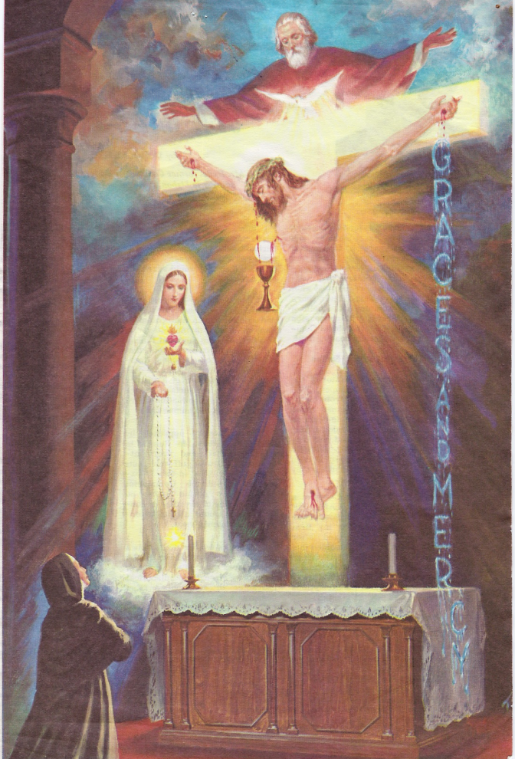
The Father
The Creator
Trinity – One God
  Three persons
    Father
    Son
    Holy Spirit
Painting from an appreciation to Sr. Lucy of Fatima

Slide 16
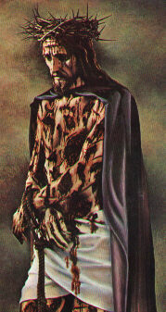
Jesus – The Son
The Word
In the Beginning was the Word
He suffered and die on the cross for our sins and opened up the gate to Heaven
His story is the new testament

Slide 17

Holy Spirit
Explains the classic seven Gifts of the Holy Spirit and how to obtain them. It shows how the Holy Ghost works in our souls, and what the soul is like with the Holy Spirit and also without Him. Plus, contained here are many prayers to the Holy Spirit that will draw us closer to Him.

Slide 18

The Angels
Saint Michael
Saint Raphael
Saint Gabriel
7 Archangels
7 Orders of Angels
Guardian Angels
  Each person

Slide 19
COVENANTS
1. THE EDENIC--Man's Dominion over Creation... A charge and a test
2. THE ADAMIC--The entry of sin necessitated a hope and discipline.
3. THE NOAHIC--Greater discipline, new start... promise of the Redeemer
4. THE ABRAHAMIC COVENANT
5. THE MOSAIC COVENANT
6. THE DAVIDIC COVENANT
7. THE NEW COVENANT OF OUR LORD JESUS CHRIST
Notes:
God has made several promises with His people with the last being the Covenant of Jesus

Slide 20
The Old Testament
History & Creation
Prophets
Kings
God will send The Messiah
Predicts how the Messiah will be received and what He will do
Notes:
The Old Testament tells of God and His People the Jews

Slide 21
THE TEN COMMANDMENTS
You shall not have other gods besides me.
THE NAME OF THE LORD IS HOLY
Remember the Sabbath day, to keep it holy.
You shall not take the name of the Lord in vain
YOU SHALL LOVE YOUR NEIGHBOR AS YOURSELF
You shall not kill.
You shall not commit adultery
You shall not steal
You shall not bear false witness against your neighbor.
You shall not covet your neighbor's goods

Slide 22
The New Testament
Mathew
Mark
Luke
John
Inspired by the Holy Spirit
The Public Life of Jesus and Apostles

Slide 23
The Apostles
Peter
John
Mark
Andrew
Jude
Thomas
Matthew
James Major
James Minor
Bartholomew
Matthias
Simon
Notes:
Jesus’s choices for followers were fisherman, tax collectors – all simple people AND
One of the 12 turned on Him

Slide 24
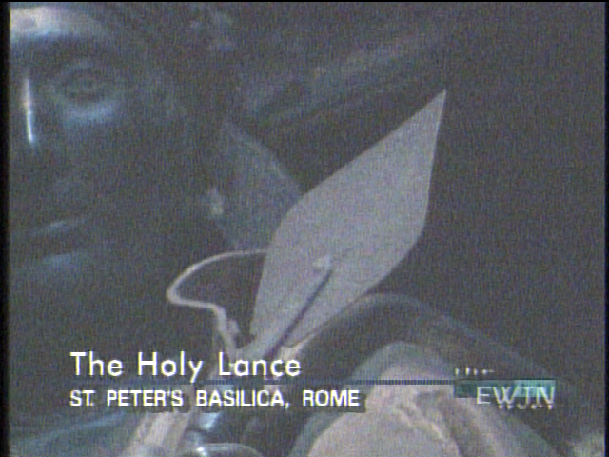
The Holy Lance
The lance that pierce the side of Jesus is located in Saint Peter’s in Rome

Slide 25
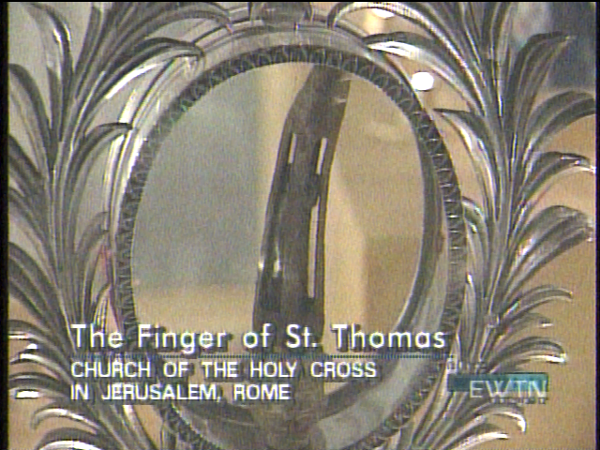
The Finger of Saint Thomas
The finger which was placed into Jesus’s wounds

Slide 26
The Early Writings of the Apostolic Fathers of the Church

Slide 27
The Writings of the Fathers Down to A.D. 325
Volume I. The Apostolic Fathers with Justin Martyr and Irenaeus
Clement of Rome, Mathetes, Polycarp, Ignatius, Barnabas, Papias, Justin Martyr, Irenaeus
Also available: text.zip, WinHelp.zip, Microsoft Reader, pdf
Volume II. Fathers of the Second Century
Hermas, Tatian, Theophilus, Athenagoras, Clement of Alexandria
Also available: pdf, text.zip WinHelp.zip, hermas.rtf
Volume III. Latin Christianity: Its Founder, Tertullian
Three Parts: I. Apologetic; II. Anti-Marcion; III. Ethical
Also available: text.zip, WinHelp.zip
Volume IV. The Fathers of the Third Century
Tertullian Part IV; Minucius Felix; Commodian; Origen
Also available: text.zip, WinHelp.zip
Volume V. The Fathers of the Third Century
Hippolytus; Cyprian; Caius; Novatian; Appendix
Also available: text.zip, WinHelp.zip
Volume VI. The Fathers of the Third Century
Gregory Thaumaturgus; Dinysius the Great; Julius Africanus; Anatolius and Minor Writers; Methodius; Arnobius
Also available: text.zip, WinHelp.zip
Volume VII. Fathers of the Third and Fourth Centuries
Lactantius, Venantius, Asterius, Victorinus, Dionysius, Apostolic Teaching and Constitutions, Homily, Liturgies
Also available: text.zip, WinHelp.zip
Volume VIII. Fathers of the Third and Fourth Centuries
The Twelve Patriarchs, Excerpts and Epistles, The Clementia, Apocrypha, Decretals, Memoirs of Edessa and Syriac Documents, Remains of the First Ages
Also available: text.zip, WinHelp.zip
Volume X. Recently Discovered Additions to Early Christian Literature; Commentaries of Origen
The Gospel of Peter, The Diatessaron of Tatian, The Apocalypse of Peter, The Visio Pauli, The Apocalypses of the Virgin and Sedrach, The Testament of Abraham, The Acts of Xanthippe and Polyxena, The Narrative of Zosimus, The Apology of Aristides, The Epistles of Clement (Complete Text), Origen's Commentary on John, Books I-X, Origen's Commentary on Mathew, Books I, II, and X-XIV
Also available: text.zip, WinHelp.zip

Slide 28
Nicene and Post-Nicene Fathers
St. Augustine Volumes
Volume I. Prolegomena: St. Augustine's Life and Work, Confessions, Letters
Also available: text.zip, WinHelp.zip
Volume II. The City of God, Christian Doctrine
Also available: text.zip, WinHelp.zip
Volume III. On the Holy Trinity, Doctrinal Treatises, Moral Treatises
Also available: text.zip, WinHelp.zip
Volume IV. The Anti-Manichaean Writings, The Anti-Donatist Writings
Also available: text.zip, WinHelp.zip
Volume V. Anti-Pelagian Writings
Also available: text.zip, WinHelp.zip
Volume VI. Sermon on the Mount, Harmony of the Gospels, Homilies on the Gospels
Also available: text.zip, WinHelp.zip
Volume VII. Homilies on the Gospel of John, Homilies on the First Epistle of John, Soliloquies
Also available: text.zip, WinHelp.zip
Volume VIII. Expositions on the Psalms
Also available: text.zip, WinHelp.zip

Slide 29
St. Chrysostom Volumes
Volume IX. On the Priesthood, Ascetic Treatises, Select Homilies and Letters, Homilies on the Statutes
Volume X. Homilies on the Gospel of St. Matthew
Volume XI. Homilies on the Acts of the Apostles and the Epistle to the Romans
Volume XII. Homilies on First and Second Corinthians
Volume XIII. Homilies on the Epistles to the Galatians, Ephesians, Philippians, Colossians, Thessalonians, Timothy, Titus, and Philemon
Volume XIV. Homilies on the Gospel of St. John and the Epistle to the Hebrews

Slide 30
Nicene and Post-Nicene Fathers
Series II
Volume I. Eusebius: Church History from A.D. 1-324, Life of Constantine the Great, Oration in Praise of Constantine
Volume II. Socrates: Church History from A.D. 305-438; Sozomenus: Church History from A.D. 323-425
Volume III. Theodoret, Jerome and Gennadius, Rufinus and Jerome
Volume IV. Athanasius: Select Writings and Letters
Volume V. Gregory of Nyssa: Dogmatic Treatises; Select Writings and Letters
Volume VI. Jerome: Letters and Select Works
Volume VII. Cyril of Jerusalem, Gregory Nazianzen
Volume VIII. Basil: Letters and Select Works
Volume IX. Hilary of Poitiers, John of Damascus
Volume X. Ambrose: Select Works and Letters
Volume XI. Sulpitius Severus, Vincent of Lerins, John Cassian
WinHelp.zip
Volume XII. Leo the Great, Gregory the Great
Volume XIII. Gregory the Great II, Ephriam Syrus, Aphrahat
Volume XIV. The Seven Ecumenical Councils

Slide 31
The Sacraments
Baptism
Confirmation
Eucharist
Reconciliation
Anointing of the Sick
Marriage
Holy Orders

Slide 32
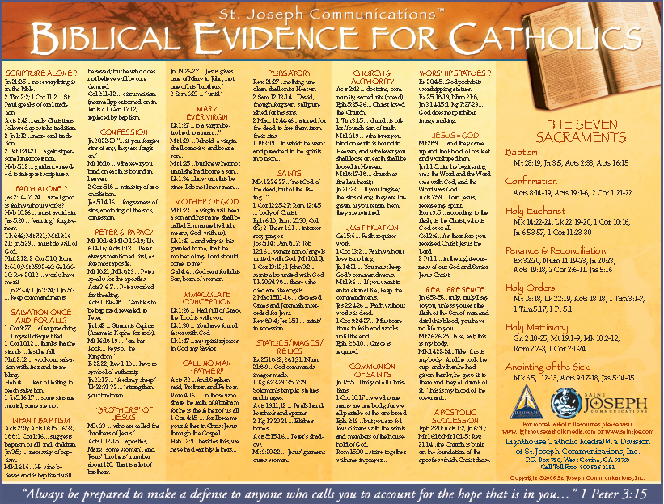
Catholic justification for sacraments

Slide 33
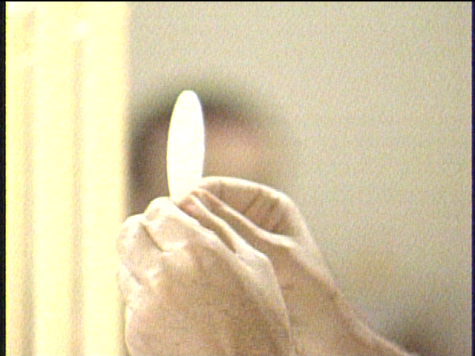
The Mass
The Greatest Prayer
Established by Jesus at the Last Supper
The non-bloody recreation of the crucifixion
Transubstantiation
Eucharistic Miracles

Slide 34

Eucharistic Miracles
The story of 36 major Eucharistic Miracles from Lanciano, Italy in 800 to Stich, Bavaria in 1970. Details the official investigations. Tells where some are still venerated today. Covers Hosts that have bled, turned to flesh, levitated, etc.; plus, of Saints who have lived on the Eucharist alone. Reinforces the Church's doctrine of the Real Presence of Jesus in the Blessed Sacrament

Slide 35
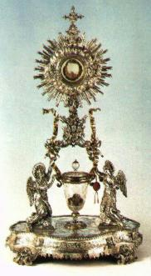
Lanciano
Perpetual Eucharistic Adoration is the adoration of Jesus Christ present in the Holy Eucharist. In the many Churches that have this adoration, the Eucharist is displayed in a special holder called a monstrance, and people come to pray and worship Jesus continually throughout the day and often the night. Christ’s great love for us was shown when he was crucified on the cross to pay the penalty for our sins and give us eternal life. He loves us without limit, and offers Himself to us in the Holy sacrament of the Eucharist. Can we not give Jesus a few minutes of love and adoration in return?

Slide 36

Lanciano, Italy -- 8th century A.D.
A priest has doubts about the Real Presence; however, when he consecrates the Host it transforms into flesh and blood. This miracle has undergone extensive scientific examination and can only be explained as a miracle. The flesh is actually cardiac tissue which contains arterioles, veins, and nerve fibers. The blood type as in all other approved Eucharistic miracles is type AB! Histological micrographs are shown.

Slide 37
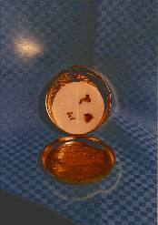
Betania
"So Jesus said to them, 'Truly, truly, I say to you, unless you eat the flesh of the Son of man and drink his blood, you have no life in you; he who eats my flesh and drinks my blood has eternal life, and I will raise him up at the last day. For my flesh is food indeed, and my blood is drink indeed.'"
(John 6:53-55)

Slide 38
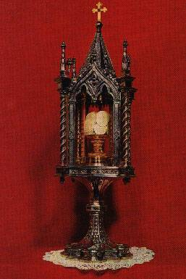
Sienna, Italy –
August 17, 1730
Consecrated Hosts remain perfectly preserved for over 250 years. Rigorous scientific experiments have not been able to explain this phenomena.

Slide 39
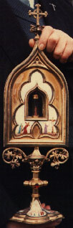
Blanot, France -- 1331
The Eucharist falls out of a woman's mouth onto an altar rail cloth. The priest tries to recover the Host but all that remains is a large spot of blood the same size and dimensions as the wafer.

Slide 40
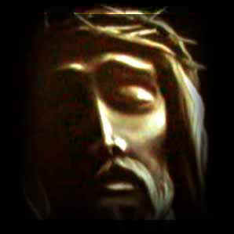
Stations of The Cross
Christ condemned to death;
the cross is laid upon him;
His first fall;
He meets His Blessed Mother;
Simon of Cyrene is made to bear the cross;
Christ's face is wiped by Veronica;
His second fall;
He meets the women of Jerusalem;
His third fall;
He is stripped of His garments;
His crucifixion;
His death on the cross;
His body is taken down from the cross; and
laid in the tomb.

Slide 41
Other Gifts
“The Rosary of the Virgin Mary”
The Papacy
Grace
Indulgences
Church History
Prayers
Relics
Music, Art

Slide 42

The Holy House
The Holy Land had seen its last and truly unsuccessful Crusade in 1291. The last of the Christian soldiers withdrew from Nazareth the same year leaving behind the holiest of houses - unprotected. It was to be dealt with according to the Moslem tradition of pillaging and destruction. It may seem farfetched to think that a tiny clay house venerated by a handful of Christians could merit such vindictive rage. But this was a unique house - visibly an edifice of mud and straw but preserving within its framework living memories of its Royal Household - Jesus, Mary and Joseph.
Notes:
Towards the end of the thirteenth century, the terrible news reached Europe that the Holy Land was lost to the Christians. The holy house of Nazareth, site of the birth of the Mother of God, of Her early education and of the Annunciation by the Angel Gabriel, had been found, transported miraculously in Dalmatia (Yugoslavia) on the year 1291. The house moved again, after robbers began to intercept pilgrims coming through the forest to visit the marvel. Loreto became its permanent site. The episodes concerning the Translation of the Holy House, all duly verified, were consigned in documents borne to Rome at various epochs.

Slide 43

Mystical City of God
The Mystical City of God; is the collected revelations made by the Blessed Virgin Mary to the Venerable Mary of Jesus of Agreda (a 17th Century nun). This book has been acclaimed by Popes, cardinals, theologians, as well as the clergy and the laity for over 300 years. The Mystical City of God has been published in sixty editions in various languages.
The translator, Father George J. Blatter, a Chicago priest, first read the book in German and was so impressed that he learned the Spanish language in order to make a proper translation into English. His first edition appeared in 1912, ten years after he started his work.
The book that we choose to promote is a popular abridgment (794 pages) of the original Mystical City of God (2,676 pages). The purpose of the abridgement is to bring to an even wider readership the sublime truths found in The Mystical City of God.
Notes:
Our Queen and Lady, if you wish again to hear us speak of the tokens of thy beloved that we know of, consider that He is beauty itself and that He contains within Himself all the perfection's beyond all desire. He is amiable without defect, delightful beyond comparison, pleasing without the least flaw. In wisdom He is inestimable, in goodness without measure, in power boundless, in greatness immeasurable, in essence infinite. In judgements He is terrible, His counsels inscrutable, in His words most true, in His works holy, rich in mercies. Space cannot overreach Him, narrowness cannot confine Him, sorrow cannot disturb Him, joy cannot cause any change in Him; nor does He ever fail in His Wisdom, or change in His will; abundance cannot overwhelm or want come near Him; memory adds nothing, forgetfulness takes nothing from His knowledge; what was is not past for Him; the beginning gave no origins to His being, and time will bring to Him no end. Without being caused, He causes all things, and He has not need of anything but all things need participation in Him; He preserves them without labor, He governs them without confusion. Those who know Him are happy, who love and extol Him, are blessed; for He exalts His friends, and at last glorifies them by His eternal vision and loving friendship.

Slide 44
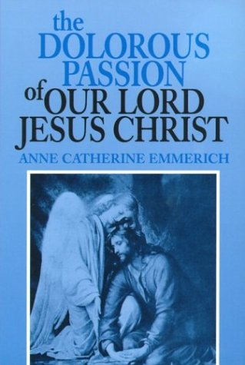
The Passion of Our Lord
Faithful to the Bible story of the Passion and death of Jesus, it fills in many details and is edifying and inspiring beyond belief; plus, it is surprising and heart-rending. It will melt a heart of stone. This book is the best on the Passion we have seen. It is also wonderful on the Blessed Mother's role in our redemption. Includes a short biography of Sr. Emmerich. A great, great book for the whole family!

Slide 45
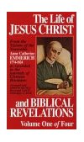
The Life of Jesus Christ
This extraordinary work contains a day-by-day and frequently hour-by-hour account of the three years of the Public Life of Christ, actually witnessed in vision by one of the greatest mystics of the 18th century. Besides dealing with the most profound mysteries of Judaism and Christianity, the narration includes a complete life of the Blessed Mother and extensive biographies of Noah, Abraham, the ancestors of the Holy Family, John the Baptist, the Apostles, Mary Magdalene, Judas and many intimate revelations about St. Joseph, St. Anne, St. Joachim and other relatives of Our Lord. Includes an account on the Creation of the World (Astounding!) as well as a wealth of information regarding the culture, customs, architecture, geography and even the weather conditions of ancient Palestine. Describes events from the Apostle's early missionary work, plus the death of the Blessed Mother. A treasure trove of information obtainable from no other source. Seems an act of God that these visions were permitted and recorded. The tremendous detail of these unusual volumes, along with the saintly, dignified style with which the story is related, will truly inspire the reader and bring him rich spiritual rewards. "From our own deep conviction of the great advantage to be derived from the pious perusal of the work . . . we do not hesitate in its approval to add our signature " . . . James Cardinal Gibbons.

Slide 46
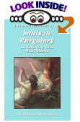
Souls in Purgatory
Ever wanted to get a short, non-complicated, clear answer about purgatory? Most books deal with theology, opinions of it existence and more spiritual reasons for purgatory. This book just answers in everyman's language some basic questions. By giving examples of souls in purgatory and giving us the sin that most people commit that leads us there, it also helps us see where we might end up. At the end of the book, it gives us ways to help those in purgatory to be released into heaven. If you couldn't help those you love while they were alive, it gives us a way to help them now.

Slide 47
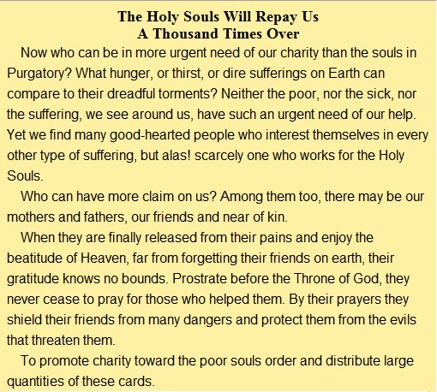
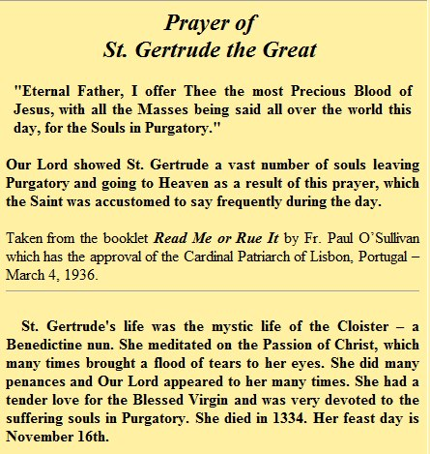
PRAY FOR THOSE IN PURGATORY

Slide 48
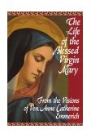
Life Of Mary
Anne Catherine Emmerich gives the "everyday" happenings in the lives of those she "observed". I thought this book was a lovely read, and give me renewed interest in the Bible itself. As with all her books, it is like reading the full story as opposed to the headlines. Because Anne Catherine was a nun, it is often supposed that this, and indeed all her books, are only for Catholics. However, for Jewish people, it gives a most profound knowledge of the rich Jewish culture two thousand years ago, and for Christians, it fills in the blanks that Mathew, Mark, Luke and John left - they probably didn't realize that two thousand years later, their readers would not know what a Jewish wedding was like (Mary's dress and hair do left me breathless!). After reading the Chapter of Christmas, you too will wonder how Santa Claus managed to take over this wonderful event. I have also read the four volumes of the Life and Passion of Our Lord. Easter has never been the same for me.

Slide 49
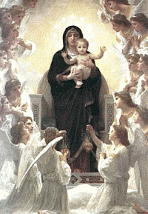
Mary
Pray to for Intercession
Mother Of Jesus
Apparitions
Miracle of Cana

Slide 50
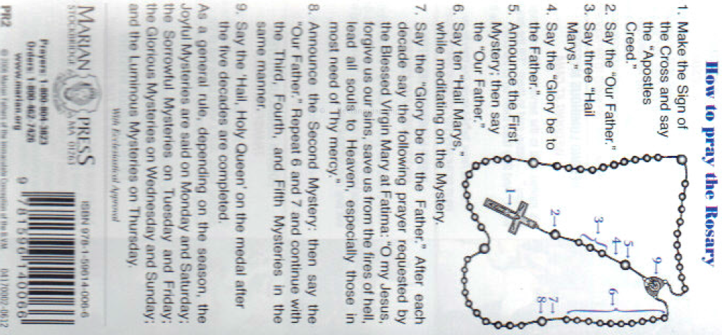
The Rosary

Slide 51
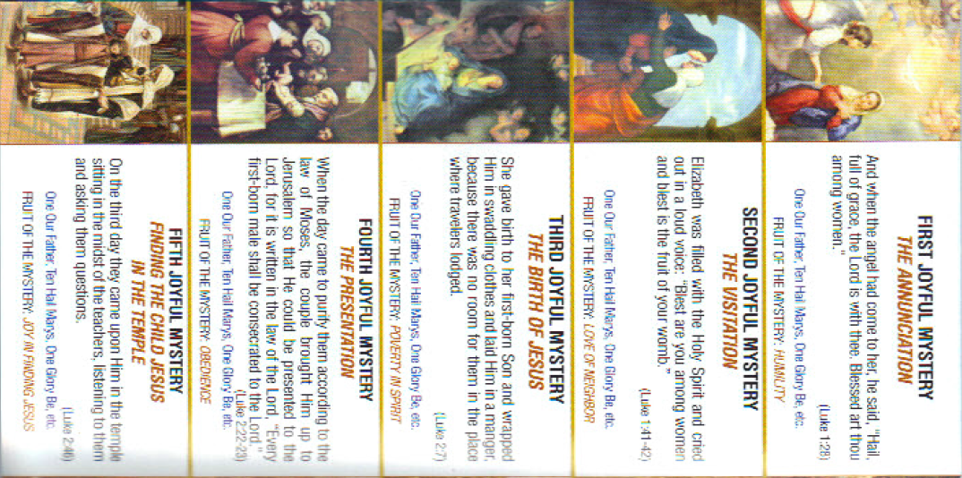
Joyful

Slide 52
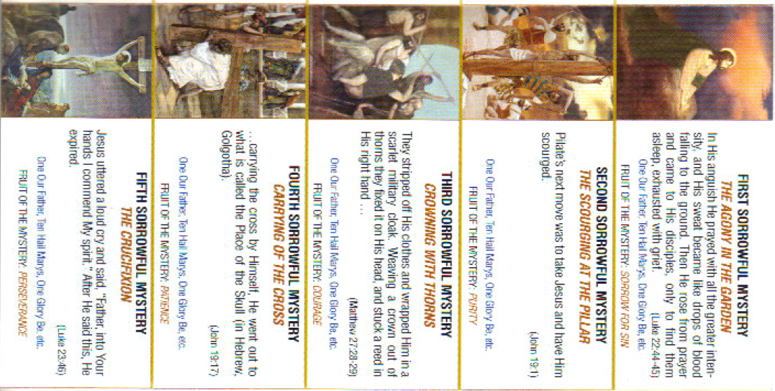
Sorrowful

Slide 53
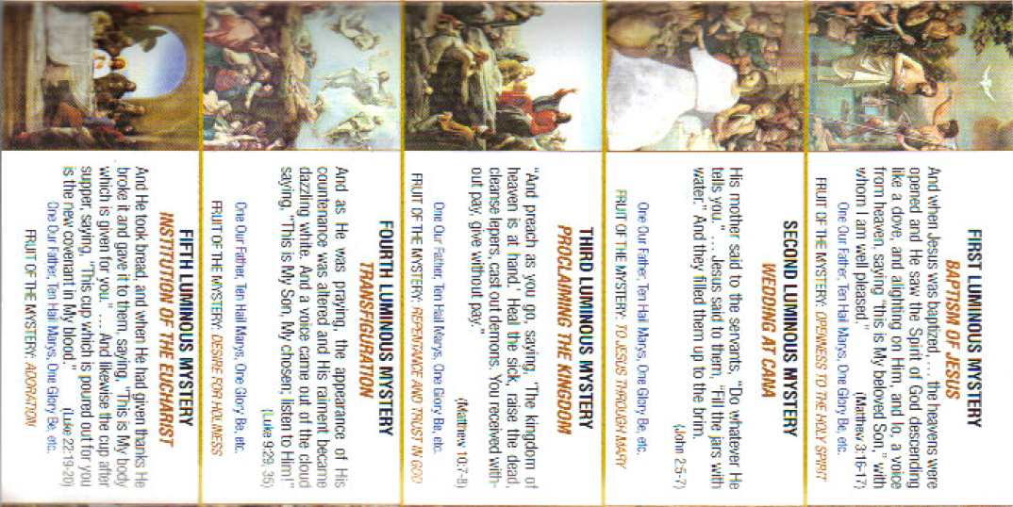
Luminous

Slide 54
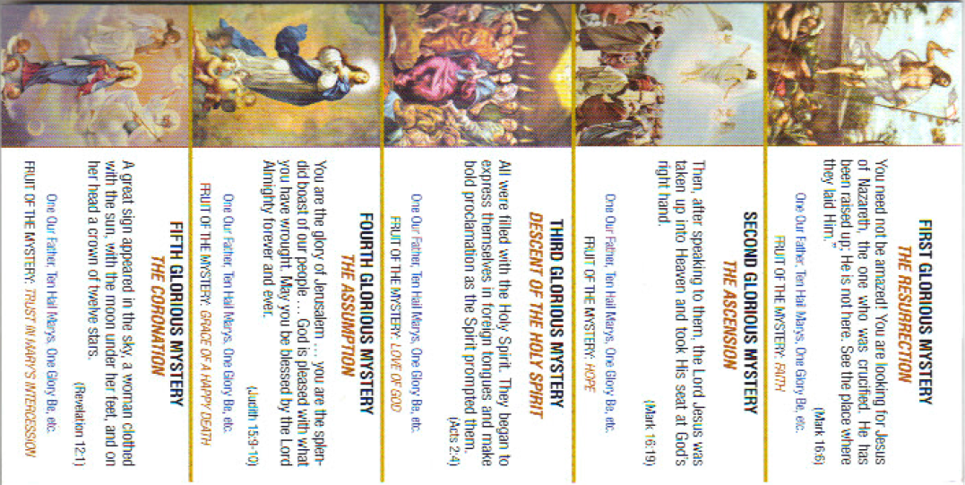
GLORIOUS

Slide 55
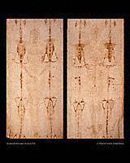
The Shroud
Why people believe
  Never seen one like it
  Not painted
  Layered
  3-D
  Physical
  Describes Jesus’s suffering

Slide 56
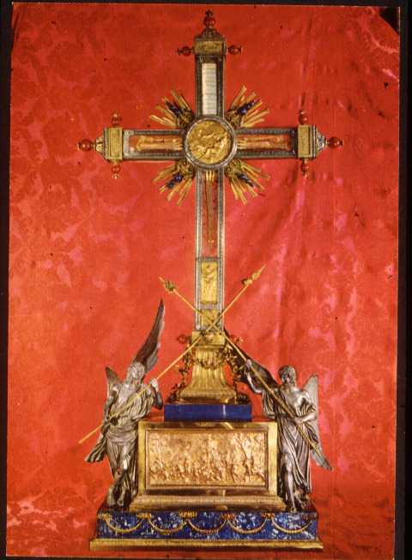
The Crucifix
Relic of the True Cross
Saint Helena

Slide 57
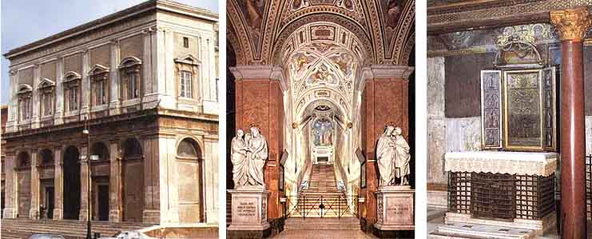
The Holy Stairs
Notes:
For centuries, the Scala Santa (Holy Stairs) has attracted Christian pilgrims who wished to honor the passion of Jesus. The stairs are, reputedly, the stairs from Pilate's residence in Jerusalem that Jesus ascended to be judged by the Roman procurator and then condemned to death. Tradition says they were brought to Rome and located in the complex of buildings around the Basilica of Saint John Lateran. The stairs lead to the Sancta Sanctorum, the personal chapel of the early Popes, where papal relics and an ancient image of Jesus Christ have been kept for centuries. above, from left: exterior, Holy Stairs, Sancta Sanctorum.

Slide 58
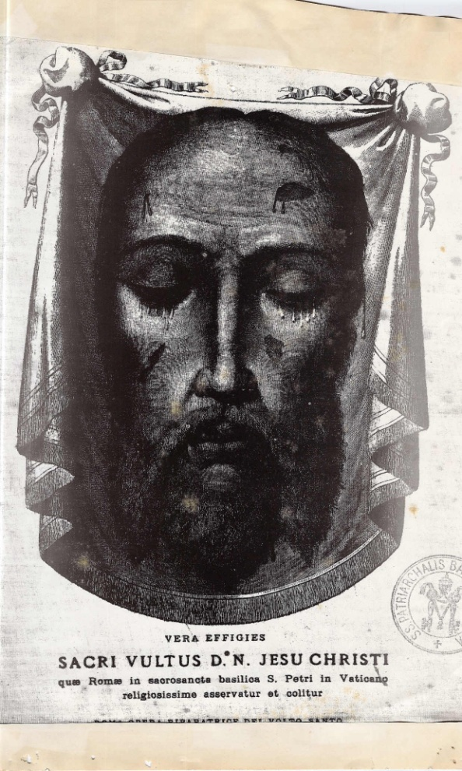
Veronica’s veil
Copy of the Image of Jesus during his carrying of the cross

Slide 59
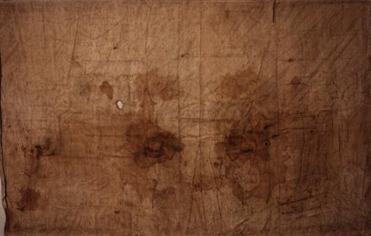
The Sudarium of Oviedo
According to this history, the Sudarium was in Palestine until shortly before the year 614, when Jerusalem was attacked and conquered by Chosroes II, who was king of Persia from 590 to 628. It was taken away to avoid destruction in the invasion, first to Alexandria by the presbyter Philip, then across the north of Africa when Chosroes conquered Alexandria in 616. The Sudarium entered Spain at Cartagena, along with people who were fleeing from the Persians. The bishop of Ecija, Fulgentius, welcomed the refugees and the relics, and surrendered the chest, or ark, to Leandro, bishop of Seville. He took it to Seville, where it spent some years.

Slide 60
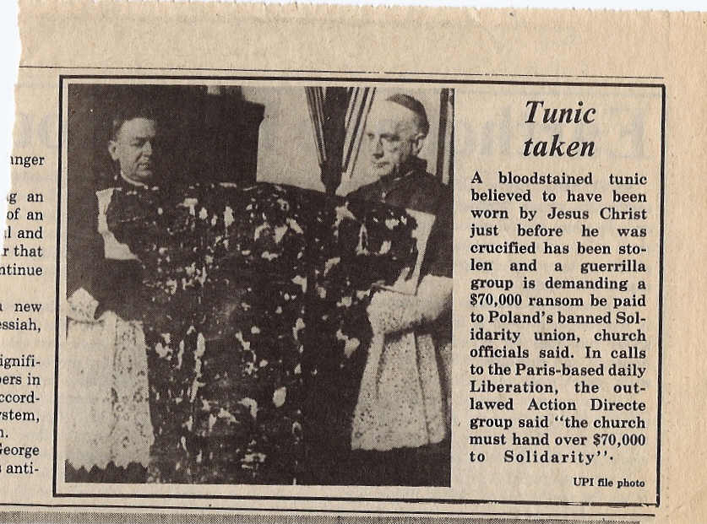
Jesus’s Tunic

Slide 61
The Beatitudes
(Mathew 5: 3 -12)
Blessed are the poor in spirit, for theirs is the kingdom of heaven.
Blessed are they who mourn, for they will be comforted.
Blessed are the meek, for they will inherit the land.
Blessed are they who hunger and thirst for righteousness,
for they will be satisfied.
Blessed are the merciful, for they will be shown mercy.
Blessed are the clean of heart, for they will see God.
Blessed are the peacemakers,
for they will be called children of God.
Blessed are they who are persecuted for the sake of righteousness,
for theirs is the kingdom of heaven.
Blessed are you when they insult you and persecute you (falsely)
because of Jesus.
Rejoice and be glad, for your reward will be great in heaven.
Thus they persecuted the prophets who were before you.

Slide 62
Jesus’s Suffering
Scourged
Hit
Crowned with Thorns
False testimony
Spit on
Carried Cross
Tunic ripped off dry blood
Nailed to cross

Slide 63
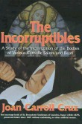
The Incorruptibles
The stories of 102 canonized Saints and Beati whose bodies were found incorrupt long periods after their deaths, many of which endured abnormally adverse conditions in remaining intact. A fascinating and absolutely documented study--and one which will reinforce people's faith in the Catholic Church--the only religion that possesses the phenomenon of bodily incorruption.
Notes:
Inside a side chapel at the cathedral of San Frediano in Lucca, Italy, bouquets of lilies and orchids perfume the air with the sweet fragrance of sanctity. A respectful hush descends over the curious and faithful alike as they gaze up at a reliquary of gold and glass. Lying on a bed of brocade is one of Roman Catholics' most beloved icons, Saint Zita. Born in 1218 in the village of Monte Sagrati, Zita led a life of singular virtue. Raised in abject poverty, she was sent out to work as a child in the home of a wealthy merchant in nearby Lucca, where her kindnesses were legion. She gave up her bed to homeless women and dispensed her own meals to the poor. When she died at around the age of 60, her body was laid to rest in a burial vault in San Frediano. Memories of her holiness remained vivid, however, and people pressed the Church to declare her a saint. When ecclesiastical officials exhumed the humble servant nearly 300 years after her death, one of the miraculous signs of sainthood was immediately apparent: Zita was whole and intact, her body resistant to the decay reserved for ordinary humans. And so she has remained through another 400 and more years. Crowned with a ring of dried pink roses and wearing a gown of soft green velvet, she lies on her bier virtually untouched by time. Her gaunt face is dark but smooth. Her hands are soft and supple looking. Her lustrous nails gleam.
Saint Zita is one of the Incorruptibles -- the name given by medieval Catholic clergy to the astonishingly preserved bodies of saints, martyrs, and beati, the blesseds on the road to canonization. Just over half of the 100 or so Incorruptibles that are known to exist lie in reliquaries in Italy. The rest are scattered around the world -- in France, Spain, Poland, Austria, Belgium, Germany, India, Peru, and Lebanon. Through the centuries, the faithful have revered these bodies as signs of divine intervention, unquestionable proof that they were God's holy servants in life. The devout believe the Incorruptibles possess miraculous healing powers. When Saint Zita was exhumed, she reputedly returned sight to the blind and fertility to the sterile.
Over the last 15 years, however, a new view of the Incorruptibles has begun to emerge. At the Vatican's request, Italian pathologists, chemists, and radiologists have been poring over the bodies of the ancient men and women interred in church reliquaries. Charged with gleaning new information about the lives of the saints and assisting in the conservation of sacred remains, they have also brought science to the altars of Europe's cathedrals. Already, they have examined more than two dozen saints and beati, shedding light on the mystery of their preservation. While some saints were clearly mummified by their devout followers, others were protected from decay by environmental conditions, raising new questions about incorruptibility. "What is a miracle?" asks Ezio Fulcheri, a pathologist at the University of Genoa and one of the leading researchers on the Incorruptibles. "It's something unexplainable, a special event that may occur in different ways." The causes may seem mysterious "but don't exclude [rare] natural processes that are different from the normal course of things."
Fulcheri's experience with the Incorruptibles began in 1986 with a strange, irresistible request from Monsignor Gianfranco Nolli, the then inspector emeritus of the Vatican's Egyptian Museum and a consultant to the Congregation for the Causes of Saints. The august body, composed of nearly two dozen cardinals, archbishops, and bishops assisted by a small core of ecclesiastical investigators and scientific consultants, works out of a brick and stone building near Saint Peter's Square. Its chief duty is to examine the lives, writings, and purported miracles of people of extraordinary holiness, referring those it deems most worthy of recognition as saints, blesseds, and martyrs to the Pope for his final decision. Nolli, an expert on Egyptian mummification, had been given an unusual project by the Congregation: Preserve the body of dissident Ukrainian cardinal Josef Slipyj, a strong candidate for canonization who had died two years earlier. The Church did not want Ukrainians to forget its opposition to the Communists: Slipyj would help them remember.
Fulcheri joined Nolli and a team of prominent Italian scientists in the chill underground crypt of Saint Sophia in Rome where Slipyj was buried. There, they carefully lifted the prelate's body from his coffin. The cadaver was still intact, but the flesh had begun to darken with decay. The team first removed the brain and viscera and cleansed the cardinal's internal cavities. Then to switch off enzymatic decay, they immersed the body in a chemical bath. Over the next four months, the team bathed the cardinal in a series of solutions. At the end of a year, Fulcheri collected tissue samples. Slipping these under the microscope, he compared them to those taken before the mummification began. The processes of cellular decay had slowed to a virtual standstill. Grateful for the news, the Vatican flew Slipyj's mummified body to the capital of the western Ukraine, Lviv, where it was buried in a cathedral crypt, awaiting canonization.
The 20th-century Catholic Church had not hesitated in calling on science for help in preserving a future saint. That sparked Fulcheri to wonder whether it had made similar appeals in ages past. The popular European and North American tradition of embalming had developed late. It was not until the 17th century that anatomists and chemists began experimentally injecting substances as diverse as wine, turpentine, alcohol, vermilion, lavender, and rosemary into the arteries of animal and human cadavers. In an era long before such chemical preservation, had science been of any help to the Church?
Fulcheri came across his first clues when Nolli called on his help once again, this time with an official examination of an important 13th-century Tuscan saint, Margaret of Cortona. According to hagiographies, Margaret, the daughter of a simple farmer, had attracted the eye of a wealthy young man. Living openly as his mistress, she flaunted his finery and bore him a son, scandalizing the countryside. After nine years, however, her lover suddenly went missing and she discovered his body in a shallow grave. Regarding this as a sign from God, she asked public pardon, then devoted her life to good works. In 1279, when the army of Charles of Anjou threatened to lay waste to Cortona, the citizens appealed to her to pray for their deliverance. Margaret reassured them that their city was in no danger, and soon after Charles signed an armistice. After her death in 1297, Margaret's remains resisted decay. Her body, which lies in a magnificent Gothic tomb in the cathedral of Cortona, "is light in color and dry, but completely whole," notes Joan Carroll Cruz in The Incorruptibles, a survey of saintly remains published in 1977. "Even the eyes are full and all the nails of the feet and hands are still in place."
In Cortona, Fulcheri joined the other examiners, taking the oath required of all participating at such proceedings: He vowed to respect the saint's remains, to take nothing, and to tell the truth about his findings. Then he and his colleagues broke the reliquary seals and carried the saint's body to a private area in the cathedral. As Fulcheri gently lifted the hem of her dress up over her legs, all those assembled began to murmur. Several long incisions streaked along her thighs; other, deeper cuts ran along her abdomen and chest. Clearly made after death, they had been sewn shut with a whipstitch in coarse black thread. Saint Margaret had been artificially mummified.
Poring over historical and ecclesiastical documents, Fulcheri made a surprising discovery: "The people [of Cortona] asked the Church to embalm her," he says. According to the records, they made this request very publicly. But over the centuries that fact had been lost. People assumed, given the state of her body, that she had been preserved by an act of God. And earlier canonical recognitions performed on her body had done little to set the record straight. The examiners had detected the fragrance of unguents and spices about her, but they had been too embarrassed to give her a full physical examination. "They had drawn back her vest, but just a little to be modest," observes Fulcheri.
Those who preserved Saint Margaret had done so remarkably thoroughly, excising her internal organs and drenching her skin in fragrant lotions. Their handiwork reminded Fulcheri of the techniques employed by ancient Egyptian embalmers. Mulling this over, the pathologist wondered whether the resemblances were merely coincidental or whether at some point in the distant past, the Catholic Church had borrowed from the Egyptian tradition of mummification. The Bible, after all, had established an important precedent. In the Old Testament, Joseph, the church patriarch who was sold into slavery in Egypt as a youth and rose to become the governor of Egypt, had commanded his servants to embalm the body of his father. Elements of this practice had likely lingered in Palestine for more than a millennium. The New Testament related how mourners at the holy sepulchre anointed the body of Christ with natural preservatives made of plants. Indeed, Nicodemus had arrived at the tomb carrying a hundred-pound weight of myrrh, the resin of choice of Egyptian embalmers, and aloes, an antibacterial residue from the various species of aloe that grow in southern and eastern Africa. "Then took they the body of Jesus, and wound it in linen clothes with the spices, as the manner of the Jews is to bury," noted the Gospel of John.
Imbued by faith, the early Christian fathers were determined to follow the example. "If Christ, as the head of the church, was oiled and embalmed," says Fulcheri, "they thought that important people and holy people should be oiled and embalmed too." So early Christians began anointing the bodies of the holy with natural preservatives and wrapping them in linen, simple acts that greatly aided the mummification of many saints. When the first Christian missionaries journeyed to Rome, they brought these customs with them, and the use of such preservatives soon became established in Europe. According to historical records, 4th-century Christians in Umbria entombed the body of Saint Emiliano with "aromatic resins and precious perfumes and white linens," and Christians continued anointing their saints and martyrs with such substances for more than another millennium. In 1697, for example, an Italian surgeon left a list of 27 powdered herbs and drugs that he had employed to preserve the body of Saint Gregorio Barbarigo. Myrrh, aloes, and frankincense, another favored Egyptian resin, headed the list. "So the ideas from Egypt were transferred to Palestine and then to Europe," says Fulcheri.
Still, the embalmers of Margaret of Cortona had gone far beyond the traditional anointing of the holy by carving into her sacred flesh. The church records offered no explanation for such drastic actions, so Fulcheri began hunting elsewhere for clues, searching to see if he could find other similarly mummified saints in Italy. His research has turned up five other similar cases -- Saint Clare of Montefalco, Blessed Margaret of Metola, Saint Catherine of Siena, Saint Bernardine of Siena, and Saint Rita of Cascia. All had resided in the Italian provinces of Umbria and Tuscany. All had lived within a relatively short period of time, from 1297 to 1447. And all were mystics of a type fashionable in northern Italy during the 14th and early 15th centuries. Their followers had been determined to preserve their bodies, but as Fulcheri could see from the records, a simple anointing wouldn't have served their purposes. Some mourners had wanted to remove the internal organs for saintly relics to be sent to churches elsewhere. Others wanted to search the organs themselves for distinguishing marks. Saint Clare of Montefalco, for example, had once told her followers: "If you seek the cross of Christ, take my heart; there you will find the suffering Lord." The nuns who had known her so well during life took this remark literally. After she died, they cut out her viscera and pored over it for signs of divine grace. They extricated three gallstones, which they regarded as symbols of the Holy Trinity, and inside her heart, they discerned signs of cardiac disease affecting the saint's papillary muscles and nearby valves and tendons. This abnormality, they concluded, resembled the outstretched body of Christ on the cross.
Not all of the Incorruptibles, however, could be chalked up so neatly to the work of surgeons. Some, such as Saint Zita, the wizened peasant saint in the flower-scented cathedral in Lucca, revealed not a trace of human intervention, as pathologist Gino Fornaciari of the University of Pisa discovered during a Church-requested examination of her body. A native of Tuscany, Fornaciari grew up hearing stories of Saint Zita. As a mummy expert at the University of Pisa, he has examined the bodies of eight Italian saints and beati, from the Blessed Diana Giuntini of Santa Maria a Monte to the famous Saint Anthony of Padua.
Working in a small curtained-off area, the pathologist and his team carefully inspected Saint Zita's body, then delicately threaded an endoscope into her chest and abdominal cavities. The gentle saint, it transpired, was no stranger to poor health. She was born with a congenital dislocation of the tibia and suffered later from tuberculosis and lead poisoning, a result, in all likelihood, of the lead she unwittingly ingested from the glazes on household pots. In addition, she must have frequently struggled for breath, thanks to anthracosis, a chronic disease of the lungs probably caused by exposure to the soot in medieval lamps. These maladies she stoically endured until she died. Still, Fornaciari could detect no trace of unguents or resins or incisions on her cadaver. Saint Zita was whole and complete, possessed of all her internal organs. "She is a very beautiful mummy," says Fornaciari, "perhaps the best mummy I know of among the saints."
It was clear that Saint Zita had escaped decay without any help from her mourners. And so, too, had several other saints known to science, including Saint Ubald of Gubbio, Blessed Margaret of Savoy, and Saint Savina Petrilli. In reading of their cases, Fulcheri wondered whether environmental conditions in Italy's churches had brought about the saints' preservation, for many had been interred before canonization in burial vaults beneath church floors. The peculiar location of these vaults had been determined early in church history. During the first century A.D., the Roman emperor Nero had found it politic to persecute Christians. An extravagant and unpopular ruler, he had been accused of setting a great fire in Rome to clear ground for a new palace. To deflect these rumors, Nero pinned the blame on Christians. He ordered the arrest of a great multitude of them and had them dragged to the Circo Vaticano. There he had them set ablaze, torn apart by dogs, and hung from crucifixes. When Nero had finally had his fill of this cruel sport, the victims' families claimed the bodies, interring them near the circus or in the underground tunnels of Rome's catacombs. Such persecutions continued sporadically at the hands of other emperors until the Christian convert Constantine finally assumed power in Rome in the early fourth century A.D. and gave Christians freedom of worship. They retrieved their martyrs and began reburying them in safer, more glorious tombs under the altars of their new churches. In Rome, Constantine himself ordered the construction of a magnificent new cathedral, the Basilica of Saint Peter, whose altar capped the original tomb of the apostle, one of Nero's victims. And from that time on, the relics of a martyr or saint were tucked beneath the altar of every new Roman Catholic church that rose in Europe.
The new church architecture ushered in a new funerary fashion. Leading citizens and pious Christians wanted to lie inside the church, as close to the altar as possible. Church authorities buried them in vaults beneath the floor. Carved out of the cool ground or lined with alkaline stone, these vaults had both chemical and climatic environments conducive to mummification. "The temperature in these crypts is quite low, and there is little temperature difference between summer and winter," Fulcheri explains. Indeed, recent excavations in Arezzo have shown just how chill such vaults were. While restoring the Basilica of St. Francis in Arezzo in 1998, workmen uncovered burial vaults containing the mummies of three wealthy citizens likely dating to the 17th and 18th centuries. Studies of the bodies by a team of Italian researchers led by Gaspare Baggieri, an expert in paleopathology at Italy's Ministry of Cultural Resources and Activities in Rome, revealed that temperatures inside the burial vault hovered at 58 degrees Fahrenheit -- a few degrees below the threshold most favorable to bacterial growth.
By the time holy figures were exhumed during beatification or canonization trials, the tombs' microclimate had sometimes desiccated their flesh, turning it to the texture of old leather. And if there was any confusion among officials about which body was the correct one, they picked the best preserved, for incorruptibility was taken as a sign of holiness. Ordinary Europeans had no idea that nature had such preservative power, and at a time when nearly every villager or city dweller had seen rancid corpses strewn along streets, an ancient preserved cadaver seemed miraculous.
In the face of science, the roman Catholic Church has now virtually abandoned the notion of incorruptibility. It no longer accepts physical preservation as one of the two miracles required before a saint can be recognized by the Pope. Still, suppressing a sense of astonishment is difficult in the presence of a saint's preserved body. It is an amazing affirmation, a testimony to one person's significance in a universe often stony with indifference. It seems to hold out hope that death will not be the end of us, that there is some salvation from the final annihilation that we fear awaits us all.
Complete article, including photographs and related websites:
http://www.discover.com/june_01/featsaints.html
ooooooooooooooooooooooooooooooooooooo
NHNE MISSION STATEMENT, CREDITS & CONTACT INFORMATION
The mission of NewHeavenNewEarth (NHNE) is to answer humankind's oldest, most perplexing questions: Who are we? Where are we from? What is the origin and purpose of life? Instead of relying on ancient or contemporary wisdom, or the knowledge of isolated experts, we are building a global network of seekers from all walks of life, from all parts of the world, lay people and professionals alike, that can pool talents, experience, and resources to unravel life's great mysteries.
We also believe that our planet is passing through a time of profound change and are seeking to create a global community of like-minded people that can safely pass through whatever changes may come our way and help give birth to a new way of life on our planet.

Slide 64
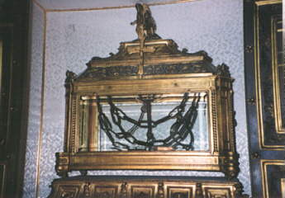
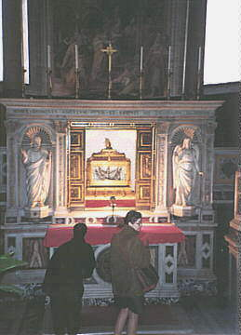
Peter’s Chains

Slide 65
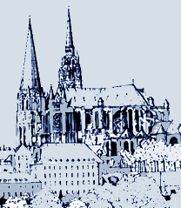
Mary’s Tunic
A prominent medieval shrine to Mary is located at Chartres, an old French city surrounded by fertile farm country about 50 miles southwest of Paris. In an ancient crypt under the magnificent 12th century cathedral, medieval pilgrims honored a prized relic of Mary -- her tunic -- which tradition said had been brought to Europe from the east by Charlemagne in the 8th century.

Slide 66
Papacy
Established by Jesus
Line of succession from Peter to John Paul II
Jesus said, “I will build my church and the gates of hell will not prevail against it!”

Slide 67
From Peter to John Paul II
Record of Popes from Peter to the current Pope ..
Jesus stated that He will establish His Church and the gates of hell will not prevail against it…
The Catholic Church is the only Christian Church established and in continuous existence since Jesus
Was Jesus wrong?

Slide 68
Papal Guidance
Encyclical Letters
Teachings of the Magesterium
Papal Infallibility
  Immaculate Conception
  Assumption of Mary

Slide 69
Religious Vocations
Priesthood
  Deacon
  Priest
  Bishop
Brothers
Sisters & Nuns

Slide 70
Visionaries and Visions
Visions of Jesus Christ.com - Catholic visionaries
Visionaries and Visions
Apparitions at Kibeho
Medjugorje Pilgrimage with Visionaries
Catholic Visionaries, Seers,Prophets, Mystics, Stigmatists

Slide 71
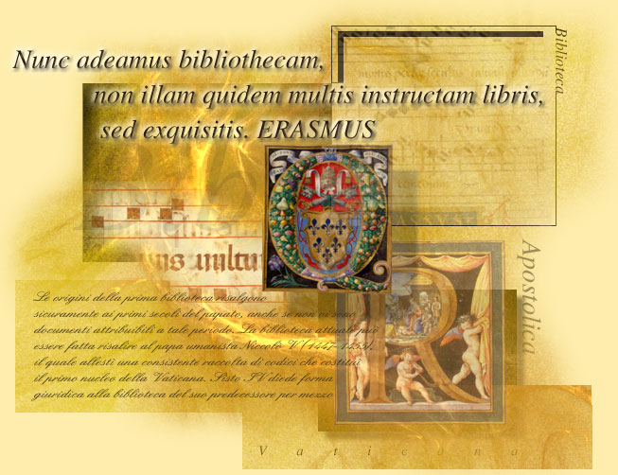
Vatican Library
Treasure of Information handled down through the generations

Slide 72
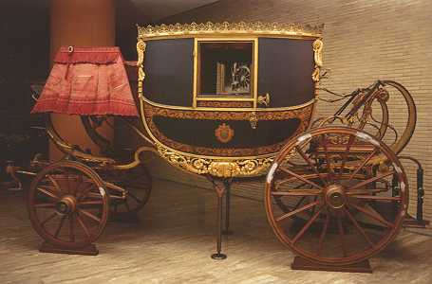
Vatican Museums
The Vatican Museums have saved precious historical items throughout many generations

Slide 73
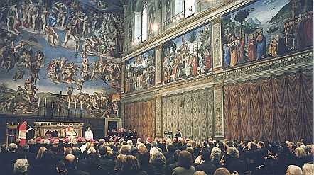
Church Art
Sistine Chapel.

Slide 74
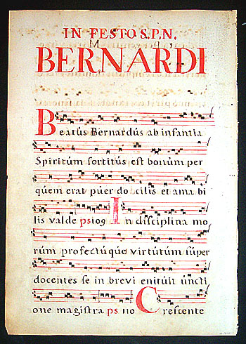
Church Music
Gregorian Chants
Gregorian Chant Home Page

Slide 75
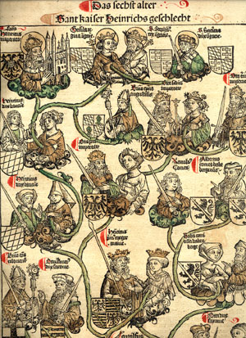
Illuminated Manuscripts
MiniaturesBibleBook of HoursBreviary
CalendarEastern & Other
Incunabula - Printed Bible Leaves
Missal
Psalter
Music - Gregorian Chants

Slide 76
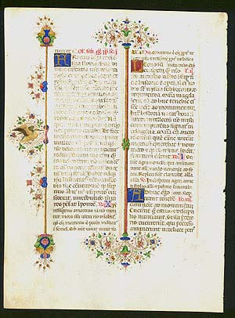
Breviary of Leonell d'Este, Duke of Ferrara, c. 1441-1448
Country of Origin: Italy (Ferrara) Time Period: c. 1441-1448 Price: $8500 Matted: 16 x 20''
IM-3376 (275x200mm – 10 ¾ x 7 7/8’’) Original leaf from a medieval manuscript Breviary of the highest quality. 30 lines of ruled text in double columns, written in Latin with dark brown and red ink in fine gothic rotunda script on animal vellum. Six two-line initials in gold on blue or rust ground with delicate gold tracery; four one-line initials decorated in blue with red pen-work. A fluted architectural column ornament is in the central margin, terminating in a sprays of flowers, fronds, and foliage in green, brown, pink, red, blue, white and gold; Marginal panels on either side, the full height of the text, consist of similar ornamentation with the verso inhabited by a bird. (For sister leaves see Weick, Late Medieval…Manuscripts, 1983 and Rendell, The Medieval World, 141 & 142). Italy, Ferrara c. 1441-1448.
This leaf comes from what was once called the Llangattock Breviary after Baron Llangattock of the Hendre, Monmouth. The manuscript was purchased in 1958 and dismantled by Goodspeed’s of Boston. Philip Hofer purchased the largest portion – the first gathering with 10 leaves. The manuscript is now known to be The Breviary of Leonello d’Este, Duke of Ferrara. According to estate records it was illuminated between 1441 and 1448 by Giorgio d”Alemagna, Guglielmo Giraldi, Magnanimo, Matteo de Pasti and Bartolomeo Beninca.

Slide 77
Grace
Actual Grace
Explains the concept of actual grace, which is defined in the article as "a supernatural help of God for salutary acts granted in consideration of the merits of Christ."
Sanctifying Grace
Describes the nature and characteristics of sanctifying grace; also treats of "justification", which is the preparation for sanctifying grace.

Slide 78
Grace (gratia, Charis), in general, is a supernatural gift of God to intellectual creatures (men, angels) for their eternal salvation, whether the latter be furthered and attained through salutary acts or a state of holiness. Eternal salvation itself consists in heavenly bliss resulting from the intuitive knowledge of the Triune God, who to the one not endowed with grace "inhabiteth light inaccessible" (I Tim., vi, 16). Christian grace is a fundamental idea of the Christian religion, the pillar on which, by a special ordination of God, the majestic edifice of Christianity rests in its entirety. Among the three fundamental ideas -- sin, redemption, and grace -- grace plays the part of the means, indispensable and Divinely ordained, to effect the redemption from sin through Christ and to lead men to their eternal destiny in heaven.

Slide 79
Actual Grace
The definition of actual grace is based on the idea of grace in general, which, in Biblical, classical, and modern language, admits of a fourfold meaning. In the first place, subjectively, grace signifies good will, benevolence; then, objectively, it designates every favour which proceeds from this benevolence and, consequently, every gratuitous gift (donum gratuitum, beneficium). In the former (subjective) sense, the king's grace grants life to the criminal condemned to death; in the latter (objective) sense the king distributes graces to his lieges. In this connection grace also stands for charm, attractiveness; as when we speak of the three Graces in mythology, or of the grace poured forth on the lips of the bridegroom (Ps. xliv, 3), because charm calls forth benevolent love in the giver and prompts him to the bestowal of benefactions. As the recipient of graces experiences, on his part, sentiments of gratefulness, and expresses these sentiments in thanks, the word gratiae (plural of gratia) also stands for thanksgiving in the expressions gratias agere and Deo gratias, which have their counterpart in the English, to say grace after meals.

Slide 80
Sanctifying Grace
A supernatural state of being infused by God into our soul that gives us participation in the divine life. The participation in the divine life is the indwelling presence of the Holy Spirit.
Sanctifying grace belongs to the whole soul, including the intellect and will. It is greater than the virtue of charity because charity belongs only to the will.
Sanctifying grace is a permanent part of our soul as long as we cooperate with its effects. When we have sanctifying grace in our soul we are said to be in the state of grace. If we pass into eternity while in the state of grace we will go either to purgatory or directly to heaven. When we commit a mortal sin, the offended Holy Spirit departs from us and we lose our sanctifying grace. If we pass into eternity while in the state of sin we will, objectively speaking, send ourselves to hell.
Actual grace helps us grow in sanctifying grace.
Sanctifying grace is sometimes called habitual grace or justifying grace.

Slide 81
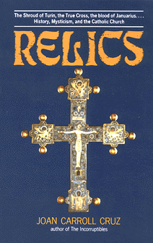
Relics
The word relics comes from the Latin reliquiae (the counterpart of the Greek leipsana) which already before the propagation of Christianity was used in its modern sense, viz., of some object, notably part of the body or clothes, remaining as a memorial of a departed saint. The veneration of relics, in fact, is to some extent a primitive instinct, and it is associated with many other religious systems besides that of Christianity. At Athens the supposed remains of Oedipus and Theseus enjoyed an honour which it is very difficult to distinguish from a religious cult (see for all this Pfister, "Reliquienkult in Altertum", I, 1909), while Plutarch gives an account of the translation of the bodies of Demetrius (Demetr. iii) and Phocion (Phoc. xxxvii) which in many details anticipates the Christian practice of the Middle Ages.

Slide 82
Sacramentals
"Sacramentals are sacred signs instituted by the Church. They prepare men to receive the fruit of the Sacraments and sanctify different circumstances of life" (Catechism of the Catholic Church #1677).
"One of the most remarkable effects of sacramentals is the virtue to drive away evil spirits whose mysterious and baleful operations affect sometimes the physical activity of man. To combat this occult power the Church has recourse to exorcism, and sacramentals" (The Catholic Encyc., 1913, VXIII, p. 293).
"Another effect is the delivery of the soul from sin and the penalties thereof. Thus in the blessing of a cross the Church asks that this sacred sign may receive the heavenly blessing in order that all those who kneel before it and implore the Divine Majesty may be granted great compunction and general pardon of faults committed. This means remission of venial sins, for the Sacraments alone, with perfect contrition, possess the efficacy to remit mortal sins and to release from the penalties attached to them" (The Catholic Encyclopedia, 1913, VXIII, p. 293).
"Sacramentals may be employed to obtain temporal favors, since the Church herself blesses objects made use of in every-day life" (The Catholic Encyclopedia, 1913, VXIII, p. 293).

Slide 83

Scapulars
Brown
In presenting the Scapular to St. Simon Stock for the world, Our Lady made but one condition to Her promise of salvation: "Whosoever dies clothed in this shall never suffer eternal fire." She promises that anyone who enters Her family of Carmel, and dies, shall not be lost. In effect, She is telling us that Her Scapular is our passport to Heaven. True devotion to Mary always has these notes: homage, confidence, and love. To be a sign of salvation, those three notes must be practiced perseveringly. When we invest ourselves in the Scapular we practice the homage of becoming members of the Queen's battalion, we profess confidence in Her promises, and we become Her special children of love. But, in order to be assured of salvation, we must persevere in those sentiments. By wearing the sign (Scapular) of membership until death, we can continually show the Mother of God that we venerate Her, believe in Her and love Her.
Notes:
On July 16, 1251, when the Carmelite Order was in danger of crumbling, Our Lady appeared to St. Simon Stock and gave him the Holy Brown Scapular with the treasured promise that "Whosoever dies clothed in this shall never suffer eternal fire." The trouble ceased.
Popes Urge Use Of Sacramentals In an apostolic letter Pius XII referred to the Scapular as a "Sign of consecration to the Immaculate Heart of Mary, which we are particularly recommending in these perilous times."
Leo XIII: . . . "encouraged the wearing of the Scapular by granting a plenary indulgence, applicable to the souls in purgatory, to all who visit a Carmelite Church on the Scapular Feast (July 16th)..."
Paul VI: "You will make known our will and our exhortations which we base upon the dogmatic constitution of the Ecumenical Council Vatican II which is in complete conformity with our thought and indeed upon which our thought is based: 'That one ever hold in great esteem the practices and exercises of the devotion to the most Blessed Virgin which have been recommended for centuries by the Magisterium of the Church' (-67). And among them we judge well to recall especially the Marian Rosary and the religious use of the Scapular of Mount Carmel."
John Paul II: In his audience of January 10, 1979, Pope John Paul II, who daily prays the Rosary and urges all to pray it, underlined the supreme role of devotion to Mary in the family theme, and the importance of the Rosary as a family devotion. The Holy Father then introduced a new thought which, in effect, makes 1979 and indeed every year a Marian Year. Our Holy Father not only became enrolled in the Scapular of Mt. Carmel, but is a member of the Carmelite Third Order!! (Soul Magazine: Mar.-Apr. 1979).

Slide 84
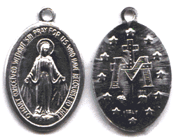
Miraculous Medal
O Mary, conceived without sin, pray for us who have recourse to thee.
Notes:
The Miraculous Medal Story and Its Meaning
The Medal of the Immaculate Conception — popularly known as the Miraculous Medal — was designed by the Blessed Virgin herself! No wonder, then that it wins such extraordinary graces for those who wear it and pray for Mary's intercession and help.
The First Apparition
The story begins on the night of July 18-19, 1830. A child (perhaps her guardian angel) awakened Sister (now Saint) Catherine Labouré, a novice in the community of the Daughters of Charity in Paris, and summoned her to the chapel. There she met with the Virgin Mary and spoke with her for several hours. During the conversation Mary said to her, “My child, I am going to give you a mission.”
The Second Apparition
Mary gave her this mission in a vision during evening meditation on November 27, 1830. She saw Mary standing on what seemed to be half a globe and holding a golden globe in her hands as if offering it to heaven. On the globe was the word “France,” and our Lady explained that the globe represented the whole world, but especially France. The times were difficult in France then, especially for the poor who were unemployed and often refugees from the many wars of the time. France was first to experience many of those troubles which ultimately reached many other parts of the world and are even present today. Streaming from rings Mary's fingers as she held the globe were many rays of light. Mary explained that the rays symbolize the graces she obtains for those who ask for them. However, some of the gems on the rings were dark, and Mary explained that the rays and graces were available but did not come because no one had asked for them.
The Third Apparition and the Miraculous Medal
The vision then changed to show our Lady standing on a globe with her arms now outstretched and with the dazzling rays of light still streaming from her fingers. Framing the figure was an inscription: O Mary, conceived without sin, pray for us who have recourse to thee.

Slide 85

The Meaning of the Front Side of the Miraculous Medal
Mary is standing upon a globe, crushing the head of a serpent beneath her foot. She stands upon the globe, as the Queen of Heaven and Earth. Her feet crush the serpent to proclaim Satan and all his followers are helpless before her (Gn 3:15). The year of 1830 on the Miraculous Medal is the year the Blessed Mother gave the design of the Miraculous Medal to Saint Catherine Labouré. The reference to Mary conceived without sin supports the dogma of the Immaculate Conception of Mary—not to be confused with the virgin birth of Jesus, and referring to Mary's sinlessness, “full of grace” and “blessed among women” (Luke 1:28)—that was proclaimed 24 years later in 1854.

Slide 86

The Meaning of the Back Side of the Miraculous Medal
The twelve stars can refer to the Apostles, who represent the entire Church as it surrounds Mary. They also recall the vision of Saint John, writer of the Book of Revelation (12:1), in which “a great sign appeared in heaven, a woman clothed with the sun, and the moon under her feet, and on her head a crown of 12 stars.” The cross can symbolize Christ and our redemption, with the bar under the cross a sign of the earth. The “M” stands for Mary, and the interleaving of her initial and the cross shows Mary’s close involvement with Jesus and our world. In this we see Mary’s part in our salvation and her role as mother of the Church. The two hearts represent the love of Jesus and Mary for us. (See also Lk 2:35).

Slide 87
Indulgences
Plenary
  Full remission of punishment due to sin
Partial
  Partial remission of punishment due to sin

Slide 88
Heaven
Father, Son and The Holy Spirit
Mary and the Saints
Angels
Seraphim
Cherubim
Thrones
Dominions
Virtues
Powers
Principalities
Archangels Michael Raphael Gabriel
Angels (Regular

Slide 89

Purgatory
A place to be purified
Part of the Body of Christ
To be prayed for
Next stop HEAVEN

Slide 90

Hell
Frightening stories of real-life experiences. Part II has a great Catholic apologetics. Covers common mortal sins, conscience, Catholic attitude, marriage, divorce, purity, etc.,

Slide 91
Catechism
Part One: The Profession of Faith
Part Two: The Celebration of the Christian Mystery
Part Three: Life in Christ
Part Four: Christian Prayer
Glossary

Slide 92
Canon Law
BOOK I : GENERAL NORMS (Cann. 1 - 6)
BOOK II : THE PEOPLE OF GOD
BOOK III : THE TEACHING OFFICE OF THE CHURCH
BOOK IV : THE SANCTIFYING OFFICE OF THE CHURCH (Cann. 834 – 848)
BOOK V : THE TEMPORAL GOODS OF THE CHURCH
BOOK VI : SANCTIONS IN THE CHURCH
BOOK VII : PROCESSES

Slide 93
Catholic Obligations
Mass on Sunday and Holydays of Obligation
Receive the sacrament of Penance during Easter

Slide 94

Prayer
Meditation
Contemplation
Vocal

Slide 95
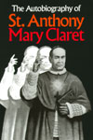
To be a light - Evangelization
Bares the soul of a saint and reveals the methods which were so successful for him in converting others. From age 5 he was haunted by the thought of the souls about to fall into Hell. This insight fueled his powerful drive to save as many souls as he could

Slide 96

Padre Pio
Famous for the stigmata, Padre Pio (d. 1968) possessed many other miraculous gifts. Describes his reading of hearts, conversions, celestial perfume, prophetic insight, bilocation, cures.

Slide 97
MORTAL AND VENIAL SIN
Mortal sin destroys charity in the heart of man by a grave violation of God's law; it turns man away from God, who is his ultimate end and his beatitude, by preferring an inferior good to him.
Venial sin allows charity to subsist, even though it offends and wounds it.

Slide 98
The Seven Deadly Sins
Pride is excessive belief in one's own abilities, that interferes with the individual's recognition of the grace of God. It has been called the sin from which all others arise. Pride is also known as Vanity.
Envy is the desire for others' traits, status, abilities, or situation.
Gluttony is an inordinate desire to consume more than that which one requires.
Lust is an inordinate craving for the pleasures of the body.
Anger is manifested in the individual who spurns love and opts instead for fury. It is also known as Wrath.
Greed is the desire for material wealth or gain, ignoring the realm of the spiritual. It is also called Avarice or Covetousness.
Sloth is the avoidance of physical or spiritual work.

Slide 99
Miracles of the Saints
Miracles of Saints
SAINTS AND MIRACLES
Spirituality, Saints and Miracles
MYSTERIES, MARVELS, MIRACLES IN THE LIVES OF THE SAINTS By Joan ...
Saints and Scientific Investigation of Miracles

Slide 100
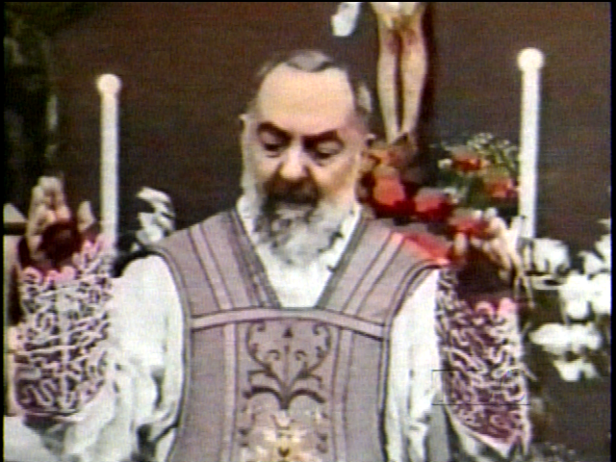
Padre Pio
Padre Pio, a humble Capuchin priest from San Giovanni Rotondo, Italy, was blessed by God in many wonderful and mysterious ways. The most dramatic was the stigmata. Padre Pio bore the wounds of Christ for fifty years!
Among his other gifts were perfume, bilocation, prophecy, conversion, reading of souls, and miraculous cures. People are still being cured through his intercession in ways that cannot be explained by medicine or science.
More important, if less spectacular, are the spiritual healings that take place in all parts of the world! Padre Pio is a powerful intercessor!!

Slide 101
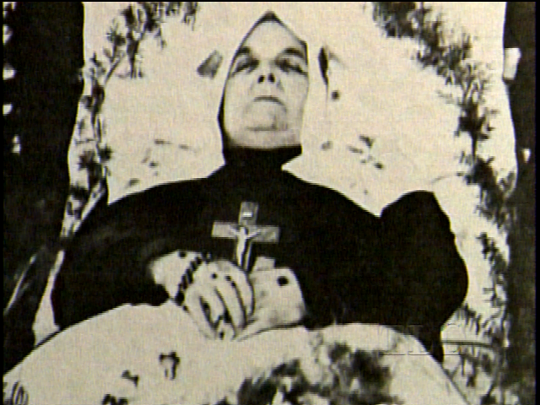
Therese Neumann
Adalbert Albert Vogl. These are the personal memories of a life-time family friend who was also an official witness in the process leading to the Cause for Therese Neumann's beatification. Here Mr. Vogl describes Therese's Passion ecstasies, her stigmata, miraculous receptions of Holy Communion, her abstinence from 1926 to 1962 from all food and drink except the Eucharistic Host, her living without sleep, her visions and the language phenomenon, her mystical recognition of priests and relics, her cures and prophecies, and her bilocation and other mystical gifts. Therese was at the pinnacle of world fame during the Nazi regime which she and her friends opposed vigorously, and an informative chapter is included showing the proportion of voters who brought Hitler to power had very few Catholics among them. 72 phenomenal black and white and color photographs graphically portray the wounds and bleeding and the Passion she experienced over 700 times. Although not told in this book, there is an often recounted story which tells that Therese is the mystic who prophecied that because of the mercy of God, bombs would not fall on U.S. soil as a reward for the generosity of the American people to many other countries of the world. But the chastisement that would befall America would be due to natural disasters and financial loss. Therese lived between 1898 and 1962 and offered her sufferings in reparation for the horrors of this century. Her life appears to be a pure gift of God as an inspiration to all of us

Slide 102
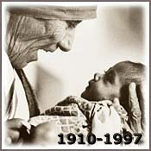
Mother Teresa

Slide 103
The Cardinal Virtues:
prudence, temperance, courage, justice
Classical Greek philosophers considered the foremost virtues to be prudence, temperance, courage, and justice. Early Christian Church theologians adopted these virtues and considered them to be equally important to all people, whether they were Christian or not.

Slide 104
The Theological Virtues:
love, hope, faith
St. Paul defined the three chief virtues as love, which was the essential nature of God, hope, and faith. Christian Church authorities called them the three theological virtues because they believed the virtues were not natural to man in his fallen state, but were conferred at Baptism.

Slide 105
The Seven Contrary Virtues:
humility, kindness, abstinence, chastity, patience, liberality, diligence
The Contrary Virtues were derived from the Psychomachia ("Battle for the Soul"), an epic poem written by Prudentius (c. 410). Practicing these virtues is alledged to protect one against temptation toward the Seven Deadly Sins: humility against pride, kindness against envy, abstinence against gluttony, chastity against lust, patience against anger, liberality against greed, and diligence against sloth.

Slide 106
The Seven Heavenly Virtues:
faith, hope, charity, fortitude, justice, temperance, prudence
The Heavenly Virtues combine the four Cardinal Virtues: prudence, temperance, fortitude -- or courage, and justice, with a variation of the theological virtues: faith, hope, and charity. I'm still researching the origins and popular usage of this formulation.

Slide 107
The Seven Corporal Works of Mercy
feed the hungry,
give drink to the thirsty,
give shelter to strangers,
clothe the naked,
visit the sick,
minister to prisoners, and
bury the dead.

Slide 108

THE BLOOD OF ST. JANUARIUS
Tradition has it that St Januarius was bishop of Benevento (a town near Naples) later to die a Christian martyr beheaded at the hands of the Emperor Diocletianus, in 305 AD at Pozzuoli.
Ceremonies in his honour were instituted by archbishop Orsini of Naples in 1337. [1] No mention of the liquefying blood was made however, until 1389, when on August 17, the phenomenon was first reported. A chronicle of Naples written in 1382 [5] describes the Januarian cult but still makes no mention of either the miracle or the relic. It is very likely that "the blood of Januarius" is one of the many relics to materialize during the Middle Ages

Slide 109
Stigmata
CATHOLIC ENCYCLOPEDIA: Mystical Stigmata
STIGMATA and STIGMATISTS, Wounds of Christ on saints
Patron Saints Index: Saint Francis of Assisi
CATHOLIC ENCYCLOPEDIA: Legends of the Saints
Catholic saints, Catholic saints directory, Catholic saints sites ...
Notes:
"Stigmata" is a Catholic phenomenon, used to describe the appearance of the wounds of Christ on a pious saint or Christian believer. It has been long debated by many who believe stigmata is instead a psychosomatic effect brought on by intense prayer. Stigmatics themselves are the main source of mystery for thousands of Christian believers. Are they really being punctured by the forces of God? Or are the wounds self-inflicted by those who harbor intense belief?
Stigmata can exists in two forms, visible and invisible. Invisible wounds are those covered by the forces of God for the inner comfort of the sufferer. Visible wounds appear on the side, palms, feet and head, and often appear and disappear in the space of a few hours. They can appear in one area alone, or all areas at once. Often, intense bleeding accompanies them, and the period before they appear is characterized by depression and weakness. Some stigmatics report feeling whips across their backs.
The first recorded case of these wounds was in the year 1222, by a man names Stephen Langton of England. St. Francis of Assissi, a famous follower of Jesus, experienced wounds in 1224.
The wounds can be experienced by both men and women. One of the more famous female stigmatics was St. Catherine of Siena, who experienced invisible wounds on her hands and feet. An interesting fact about stigmata is that it corresponds with the Passion and Death of Christ. Many wounds appear during the Last Supper, and the holy days of Easter. They disappear on Easter itself. Stigmatics reportedly speak to visions of Christ and angels during their trials, and smell strange scents. There are even reported cases of the blood types not matching between stigmata and wounds.
Stigmata has been reported everywhere from America to Italy. There are cases in France, Spain, England, and Germany. The count of these victims has stopped at 345. It is believed that there are many more, however. Among this count are some of the most famous saints, such as St. Frances of Rome of Assisi, St. Gertrude, St. Collette, St. John of God, and St. Marie of the Incarnation. They span many religious orders, including Dominican priests, Augustinian monks and the Poor Clare nuns.
One of the more interesting theories to explain this phenomenon is the idea of "theological placebo effects." According to this line of thought, stigmatics are so emotionally and physically tied to their belief that they experience a state of mind similar to raptures. It is a fact that the immune system can be controlled by the waking mind, and in some cases, a heartbeat can be consciously slowed. It is this belief that leads some to think that the wounds of the stigmata are personally, albeit unconsciously, produced.
Stigmatics still exist today. There were a reported 20 in the nineteenth century, and their numbers are diminishing. One of the most famous current stigmata is Georgio Bongiavani, who has stigmata on his hands and forehead. His religious wounds cannot be explained by any sources, and according to several news reports they appear and disappear at will.

Slide 110

Risen from the Death
the lives of St. Francis Xavier, St. Patrick, St. John Bosco, St. Catherine of Siena, St. Teresa of Avila, St. Elizabeth of Hungary, St. Rose of Lima, Bl. Margaret of Castello, etc. Includes the raising of persons who had drowned, been hanged, of those whose bodies had been mutilated, suffered decay, been reduced to skeletons or been buried for several years. Also includes young children, unbaptized infants, persons executed for a crime and persons raised to testify in criminal cases or to testify to some religious truths, and of persons who would have been condemned to Hell had they not been called back from Hell for another chance. Also, descriptions of Heaven, Hell and Purgatory by temporarily dead persons and an analysis of contemporary "after death" experiences. Plus, other wonders, such as levitation, bilocation, total abstinence from food or drink, miraculous survival of intense heat--and much, much more! Many pictures of the saints and their miracles.

Slide 111
Apparitions
Lourdes, France
Fatima, Portugal
Medjugorje, Bosnia-Herzegovina
Zeitun, Egypt
Betania, Venezuela
Naju, Korea
Akita, Japan
Garabandal, Spain
Beauraing, Belgium
San Giovanni, Italy
Knock, Ireland
Rome, Italy
La Salette, France
Guadalupe, Mexico

Slide 112

Cracow, Poland
On October 5, 1938, a young religious by the name of Sister Faustina (Helen Kowalska) died in a convent of the Congregation of Sisters of Our Lady of Mercy in Cracow, Poland. She came from a very poor family that had struggled hard on their little farm during the terrible years of WWI. Sister had had only three years of very simple education. Hers were the humblest of tasks in the convent, usually in the kitchen or the vegetable garden, or as a porter.
Notes:
On February 22, 1931, Our Lord and Savior Jesus Christ appeared to this simple nun, bringing with Him a wonderful message of Mercy for all mankind. Sister Faustina tells us in her diary under this date:
"In the evening, when I was in my cell, I became aware of the Lord Jesus clothed in a white garment. One hand was raised in blessing, the other was touching the garment at the breast. From the opening of the garment at the breast there came forth two large rays, one red and the other pale. In silence I gazed intently at the Lord; my soul was overwhelmed with fear, but also with great joy. After a while Jesus said to me,'paint an image according to the pattern you see, with the inscription: Jesus, I trust in You.'"
Some time later, Our Lord again spoke to her: "The pale ray stands for the Water which makes souls righteous; the red ray stands for the Blood which is the life of souls. These two rays issued forth from the depths of My most tender Mercy at that time when My agonizing Heart was opened by a lance on the Cross....Fortunate is the one who will dwell in their shelter, for the just hand of God shall not lay hold of him."

Slide 113

Guadalupe
Blessed Virgin appeared to Juan Diego
December 9th and 12th 1531
Guadalupe, Mexico
Notes:
Words of the Blessed Virgin spoken to Juan Diego
December 9th and 12th 1531
Guadalupe, Mexico "Know for certain that I am the perfect and perpetual Virgin Mary, Mother of the True God . . . here I will show and offer all my love, my compassion, my help and protection to the people. I am your merciful Mother, the Mother of all who love me, of those who cry to me, of those who have confidence in me. Here I will hear their weeping and their sorrows . . . their necessities and misfortunes . . . Listen and let it penetrate your heart . . . Do not be troubled or weighed down with grief. Do not fear any illness or vexation, anxiety or pain. Am I not here who am your Mother? Are you not under my shadow and protection? Am I not your fountain of life? Are you not in the folds of my mantle? In the crossing of my arms? Is there anything else you need?"

Slide 114

Lourdes
During the 18 Apparitions, the Virgin Mary spoke to Bernadette, suggesting that we come here. The response of everyone of us to that invitation is made in Lourdes to-day, a Town of Friendship, world centre of pilgrimage, a special place of meeting with God and people.

Slide 115

Fatima
The Miracle of the Sun experienced by thousands of all faiths and beliefs
Sister Lucy and the three secrets

Slide 116
The Last Fatima Vision
A vision experienced by Sister Lucy while in the convent Chapel

Slide 117

Zeitun
" Official investigations have been carried out with the result that it has been considered an undeniable fact that the Blessed Virgin Mary has been appearing on Zeitun Church in a clear and bright luminous body seen by all present in front of the church, whether Christian or Moslem"
Notes:
While all in America were watching the the Chicago riots at the Democratic Convention, or viewing live war zone broadcasts from Vietnam or were being mesmerized by the Watergate hearings on television, the Mother of God was appearing for tens of thousands to see in the land of the pyramids at a Coptic church constructed to commemorate the area in Egypt where she had come with Joseph and Jesus when they all fled from Herod. Starting in April, 1968, her apparitions of light changed the lives of thousands. Her appearances at Zeitun were astounding. She was seen by more than a million people. The apparitions were broadcast by Egyptian TV, photographed by hundreds of professional photographers and personally witnessed by Egyptian President Abdul Nasser, an avowed Marxist. The apparitions lasted for three years with numerous unaccountable healings recorded by various medical professionals. The local police, who initially thought the apparitions were an elaborate hoax, searched a 15-mile radius surrounding the site to uncover any type of device that could be used to project such images. They were completely unsuccessful.
Moslems who saw the apparitions chanted from the Koran, "Mary, God has chosen thee. And purified thee; He has chosen thee. Above all women." She was seen accompanied by doves of light in apparitions that lasted from a few minutes to as long as nine hours. Kyrillos VI, the Orthodox patriarch, formed a commission to investigate the apparitions. A number of the commissioners observed plumes of fragrant purple smoke rising from the church at the time of the apparitions and the figure of a woman surrounded by a very bright globe of light accompanied by doves of light. A digitally-enhanced, negative image of one television frame is shown at the top of this page to enable you a see an outline of what was seen by hundreds of thousands in Egypt.
While the appearances at Zietum were silent, the silence spoke volumes to those who came to see and strengthen their faith. The local Coptic Patriarch, Kyrillos VI, publicly announced a year after the apparitions started that he had no doubt that the Mother of God was appearing above the roof of St. Mary's Coptic Church.
For those who, like Thomas, needed to see for themselves, Mary offered an unequivocal televised demonstration at Zeitun. Yet, because of an unresponsive media and an indifferent world, very few outside of Egypt learned of her astonishing appearances there until well after they had ended.
More recently, the appearance of a woman clothed in light has been observed above the roof of the Church of St. Damian in Shoubra, Egypt, a suburb of Cairo. Starting in 1983 and seen with increasing frequency in the mid-1980's, the woman was seen by thousands walking above the church bathed in light in apparitions lasting up to five hours. Shenouda III, the head of the Coptic Church at the time, established a commission to investigate the beautiful lady of light. In 1987, the commission concluded:
"Let us thank the Lord for this blessing on the people of Egypt and for the repetition of this phenomenon. We should also like to thank the police and the Department of the Interior for their untiring efforts at maintaining safety and good order among the thousands of people who have spent day and night at prayer. We ask all the people to remain calm. Thus they may worthily receive the blessing of the Virgin, of St. Damian and of all the saints. May God save our country. We pray that he may guide Egypt and all her children to every success. May this phenomenon be a pledge of well-being for them and for all nations."
As in Zeitun, the silent witness of the Mother of God renewed the faith of tens of thousands and brought both Moslem and Christian to a place of peace where all could pray to the God who loved them enough to remind them of his love by sending His Mother.

Slide 118
Holy Spirit
Seven Gifts of the Holy Spirit
  wisdom,
  understanding,
  knowledge,
  counsel,
  fortitude,
  piety and
  fear of the Lord.

Slide 119
Missions
Australian Catholic Mission - aid agency and Work of the Pontifical Mission Societies giving aid to children and communities throughout the world.
Columban Fathers - hundreds of Columban priests, lay missionaries, and seminarians invite you to join us on mission.
Franciscans Missionaries of the Divine Motherhood
Holy Spirit Missionary Association - Catholic evangelization training and outreach.
Malankara Cathoic Mission of Toronto, Canada
Marist Missionary Sisters - Catholic missionary community of women who dedicate their lives to cross-cultural mission outside of their countries of origin.
Maryknoll Fathers & Brothers Africa Region - offers shared experiences of missions in Egypt, Sudan, Ethiopia, Kenya, Tanzania, Mozambique, and Namibia.
Maryknoll Mission Family - U.S. based Catholic mission movement.
Mennonite Brethren Missions and Services
Miracle of the Rosary Mission
Mission Possible - mission work in Peru and foster programs for children.
Missionary Oblates of Mary Immaculate (OMI) - contains history, news, vocation information, and more about the U.S. province of the OMIs.
Missionary Society of St. Paul@
Salesian Missions
SEDOS - a union of 90 missionary congregations, publishes a theological and missiological review with the same name.
Society for the Propagation of the Faith - Pontifical Mission Society tasked with fostering a deeper spirit of universal mission among all baptized Catholics.
Society of African Missions (Societas Missionum Ad Afros - SMA) (1)
Society of St. Paul - dynamic media mission addressing theology, scripture, philosophy, social justice, in books, audio and video tapes.
Society of the Divine Word - not-for-profit missionary order of priests and brother serving the needs of the Church around the world.
Survive-Miva - Catholic charity providing transport resources to missionaries throughout the world.

Slide 120
Catholics
Catholism by Jesus Christ
Who said: (Mathew 16:18)
And I say to thee: That thou art Peter; and upon this rock I will build my church, and the gates of hell shall not prevail against it.
Why then would people not follow the Church that Christ established?

Slide 121
World Religions
If you are a member of the Jewish faith, your religion was founded by Abraham about 4,000 years ago.
If you are a Hindu, your religion was developed in India around 1,500 B.C.
If you are a Buddhist, your religion split from Hinduism, and was founded by Buddha, Prince Siddhartha Gautama of India, about 500 B.C.
If you are a Roman Catholic, Jesus Christ began your religion in the year 33.
If you are Islamic, Mohammed started your religion in what is now Saudi Arabia around 600 A.D.
If you are Eastern Orthodox, your sect separated from Roman Catholicism around the year 1000.
If you are a Lutheran, your religion was founded my Martin Luther, an ex-Monk of the Catholic Church, in 1517.
If you belong to the Church of England (Anglican), your religion was founded by King Henry VIII in the year 1534 because the pope would not grant him a divorce with the right to remarry.

Slide 122
World Religions 2
If you are a Presbyterian, your religion was founded when John Knox brought the teachings of John Calvin to Scotland in the year 1560.
If you are a Unitarian, your religious group developed in Europe in the 1500's
If you are a Congregationalist, your religion branched off from Puritanism in the early 1600's in England.
If you are a Baptist, you owe the tenets of your religion to John Smyth, who launched it in Amsterdam in 1607.
If you are a Methodist, your religion was founded by John and Charles Wesley in England in 1744.
If you are an Episcopalian, your religion was brought over from England, to the American colonies and formed a separate religion founded by Samuel Seabury in 1789.
If you are a Mormon (Latter-Day Saints), Joseph Smith started your church in Palmyra, N.Y., NOT Salt Lake City, which would have been my guess. The year was 1830.

Slide 123
World Religions 3
If you worship with the Salvation Army (yes, it's a religious group, not just an organization that collects money in kettles on Christmas and serves dinners to the homeless), your sect began with William Booth in London in 1865.
If you are a Christian Scientist, you look to 1879 as the year your religion was founded by Mary Baker Eddy.
If you are a Jehovah's Witness, your religion was founded by Charles Taze Russell in Pennsylvania in the 1870's.
If you are a Pentecostal, your religion was started in the United States in 1901.
If you are an agnostic, you profess an uncertainty or a skepticism about the existence of God or a Higher Being.
If you are an atheist, you do not believe in the existence of God or any other higher power.

Slide 124
World Religions 4
African Religions
Afro-Brazilian Religions
Afro-Caribbean Religions
Agnosticism
Animism
Atheism
Aum Shinri Kyo
Bahá'í Faith
Buddhism
Bön
Candomblé
Cao Dai
Channeling
Christianity
Cyberculture Religion
Deism
Divination
Ethical Culture
Fourth Way
Free Daism
Gnosis
Hare Krishna
Hinduism
Humanism
Ifa
International Raelian Movement
Islam
Jainism
Judaism
Mazdaznan
Meditation
Messianic Judaism
Mithraism
Monasticism
Mysticism
Native American Religions

Slide 125
Other Faiths 5
New Age
Occult
Paganism
Pantheism
Process
Santería
Satanism
Scientology
Seicho-No-le
Shamanism
Shinto
Sikhism
Taoism
Tenrikyo
Umbanda
Unitarian-Universalism
Universal Life Church
Veda
Voodoo
Wicca
Won
Yaohushua
Zoroastrianism

Slide 126
Catholic Groups
Catholic Familyland
The Catholic Biblical Association
EWTN
Catholic Campaign for America
Natural Family Planning
Single Catholics
Jews for Jesus

Slide 127
Catholic Issues
Pro-Life
Anti- Embryonic Stem Cell Research
Media Morality
Peace on Earth
Quality of Life for All
Food for the hungry
Natural Family Planning

Slide 128
Issues 2
Homosexuality
Death Penalty
Vouchers
Cloning
Organ donation
Aids
Attending Church

Slide 129
Links
Evangelization
Catholicism Intro
Catholicism Intro I
Catholicism Intro II
Catholicism Trailer
Catholicism Promo

Slide 130
Other Presentations
Apologetics 101 Overview
The Holy Eucharist Presentation 1
The Holy Eucharist Presentation 2
Catholic Issues
Religions of The World
Catholic Basic Beliefs

Slide 131
Contact
IHS@jmja.com
www.jmja.com

